Slide 1
Android Boot Camp for Developers Using Java, 3E
Chapter 3:
Engage! Android User Input, Variables,
and Operations

Slide 2
Objectives
In this chapter, you learn to:
Use an Android theme
Add a theme to the Android Manifest file
Add text to the String table
Develop a user interface using Text Fields
Describe the role of different Text Fields
Display a hint using the Hint property
Develop the user interface using a Spinner control
Add a prompt to a Spinner control

Slide 3
Objectives (continued)
Declare variables to hold data
Code the GetText() method
Understand arithmetic operations
Convert numeric data
Format numeric data
Code the SetText() method
Run the completed app in an emulator

Slide 4
Android Themes
Engaging the user by requesting input customizes the user experience each time the application is executed
A theme is a style applied to an Activity or an entire application
Themes are Android’s mechanism for applying a consistent style to an app or Activity
The default for Nexus 5 shows the title bar displaying the app name with a white background when running the app

Slide 5
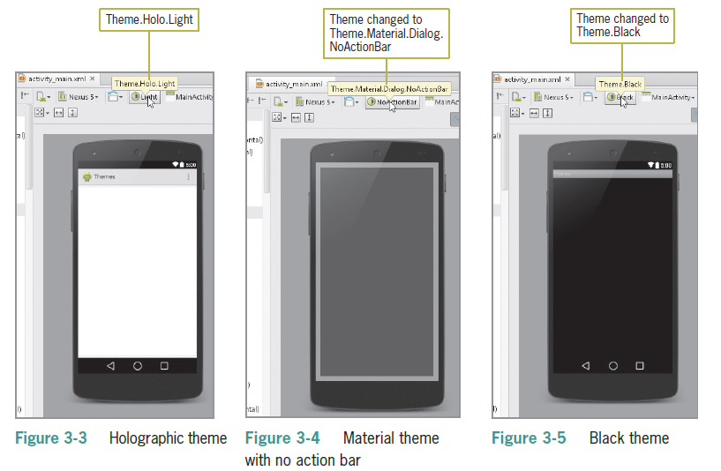
Previewing a Theme
Check the activity_main.xml file in the emulator to see what your screen looks like

Slide 6
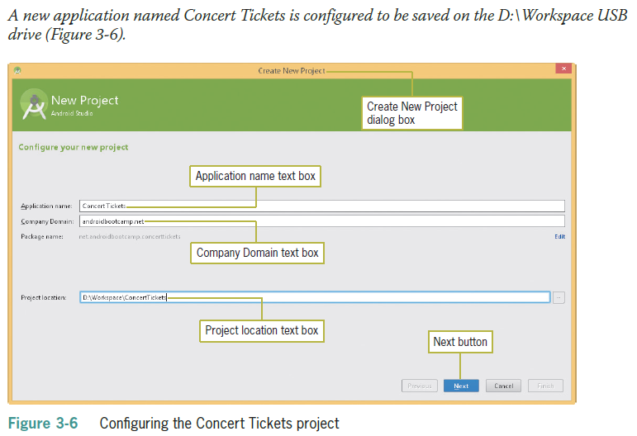
Previewing a Theme (continued)

Slide 7
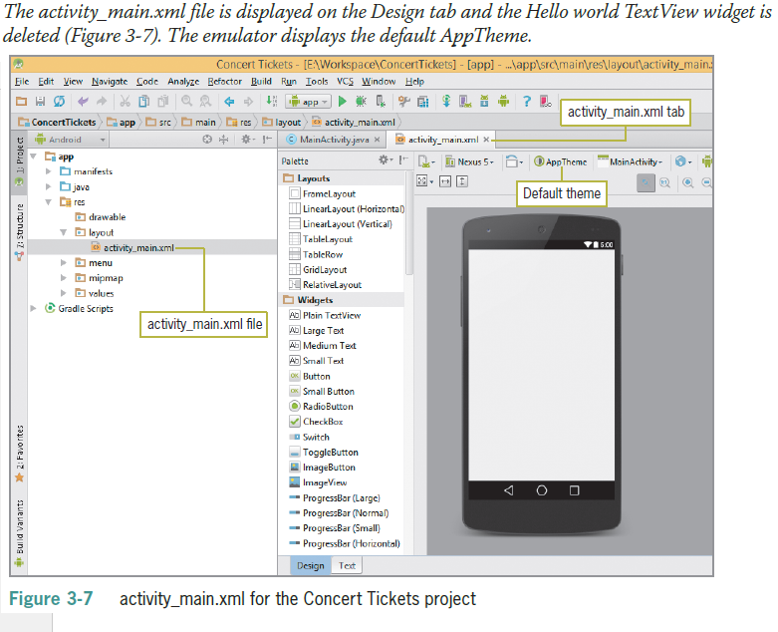
Previewing a Theme (continued)

Slide 8
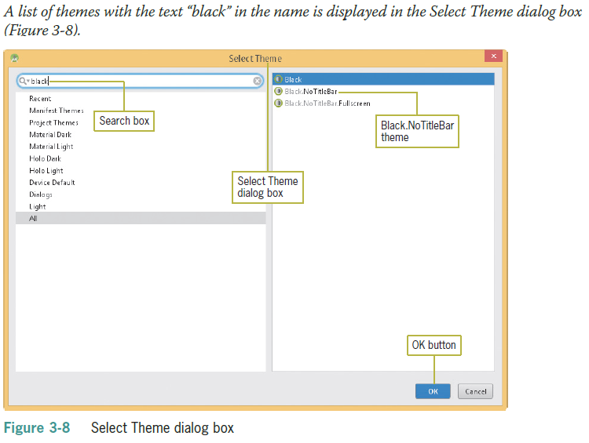
Previewing a Theme (continued)

Slide 9
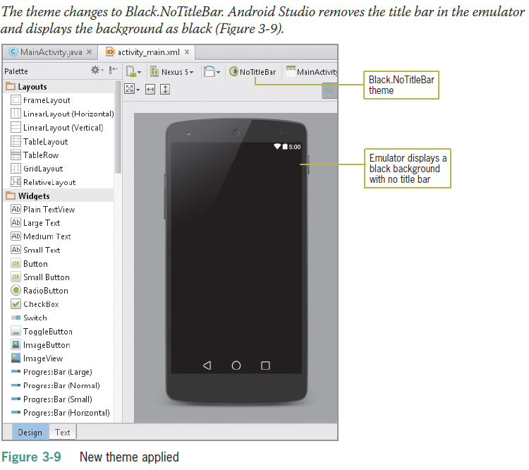
Previewing a Theme (continued)

Slide 10
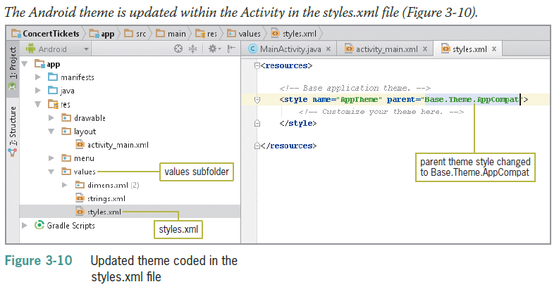
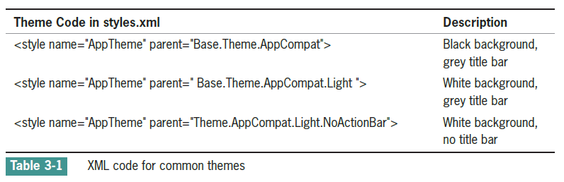
Updating the Theme in the styles.xml File

Slide 11
Simplifying User Input
The onscreen keyboard is called a soft keyboard
Input can be in the form of tapping or gestures (using two fingers to pan, rotate, or zoom)
Primary design challenge is to simplify user experiences
Use legible fonts, simplify input, and optimize each device’s capabilities to maximize user experience

Slide 12
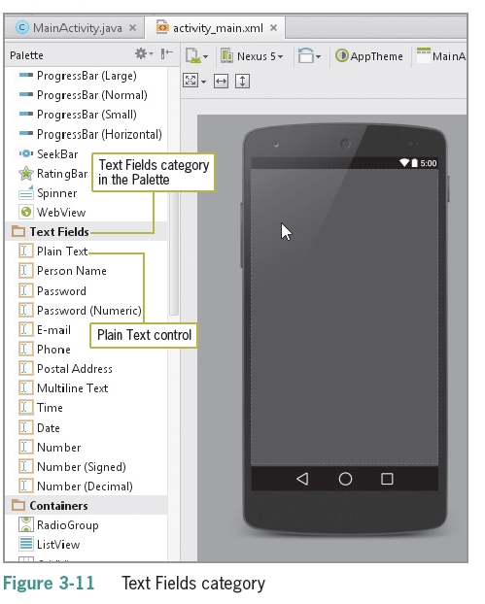
Simplifying User Input (continued)
Using Android Text Fields
Text Fields are the most common type of mobile input
Can be free-form plain text
Numbers
A person’s name, password, email, phone number
A date
Multiline text

Slide 13
Simplifying User Input (continued)
Adding a Text Field
Use the Id property in the Properties pane to enter a name that begins with the prefix txt
Use descriptive names like txtTickets instead of txtText1
Using the String Table
Uses the file strings.xml
A string is a series of alphanumeric characters that can include spaces
Localization is the use of the String table to change text based on the user’s preferred language

Slide 14
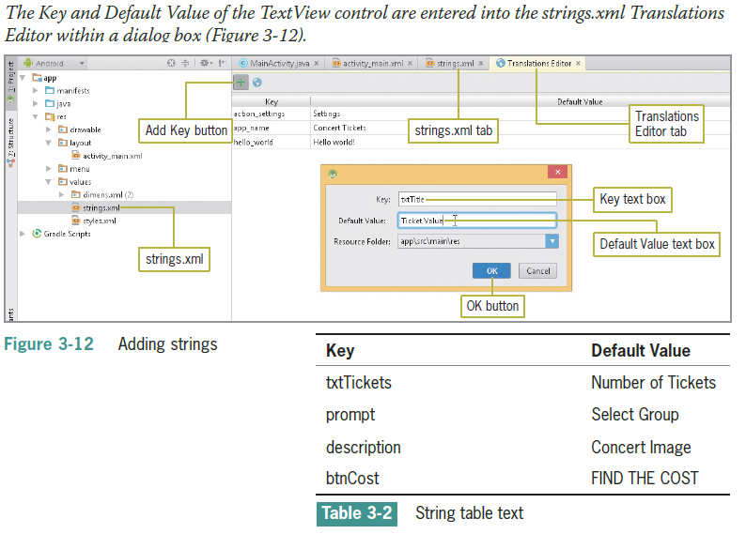
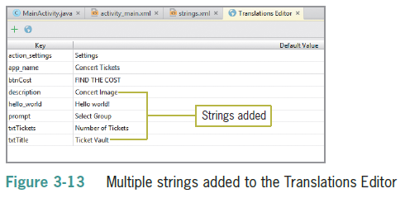
Simplifying User Input (continued)

Slide 15
Simplifying User Input (continued)
Adding a String Array
A string array defines a string resource of related items in a central location within strings.xml
An item defines an individual entry within a string array
As you type the String array XML code, the Android Studio editor offers suggestions in a panel that can complete the statement

Slide 16
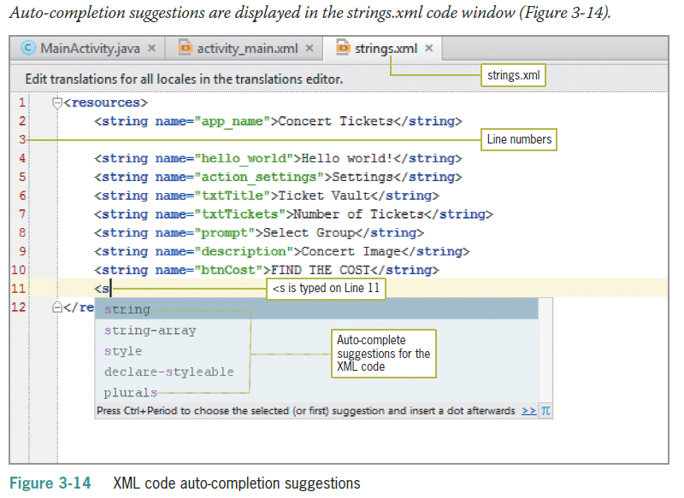
Simplifying User Input (continued)

Slide 17
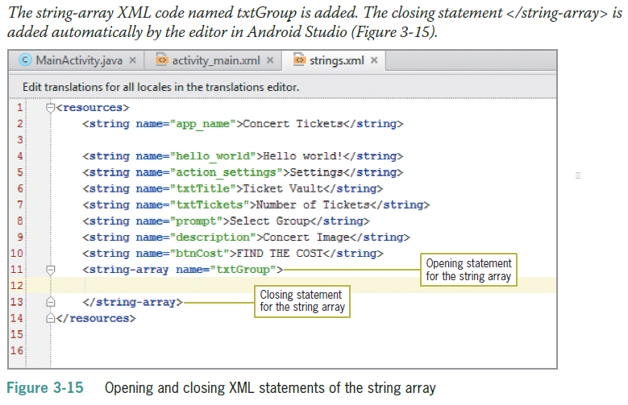
Simplifying User Input (continued)

Slide 18
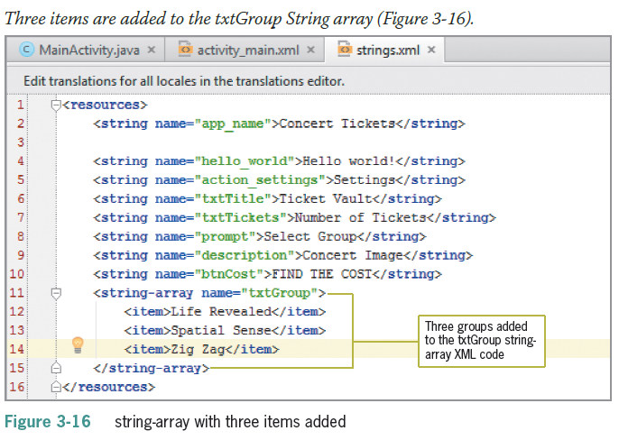
Simplifying User Input (continued)

Slide 19
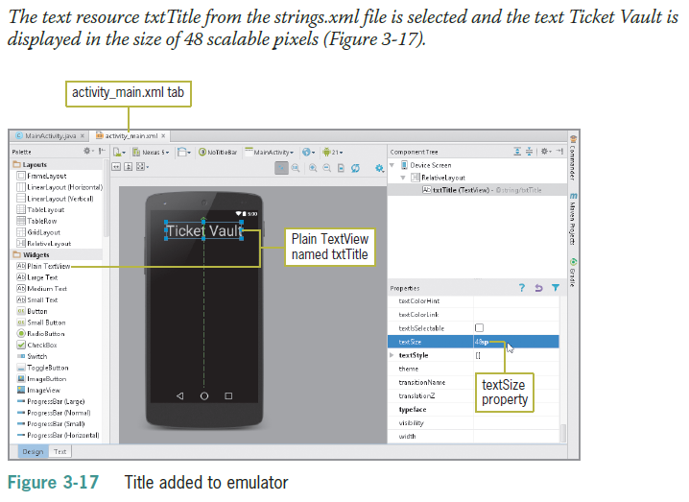
Simplifying User Input (continued)

Slide 20
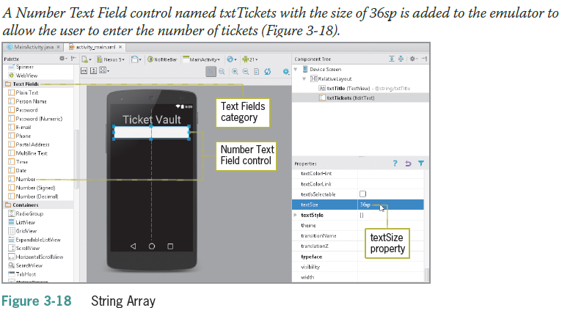
Simplifying User Input (continued)

Slide 21
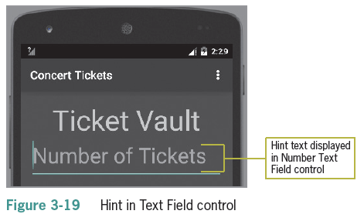
Simplifying User Input (continued)
Setting the Hint Property for the Text Field
A hint is a short description of a field visible as light-colored text (called a watermark)

Slide 22
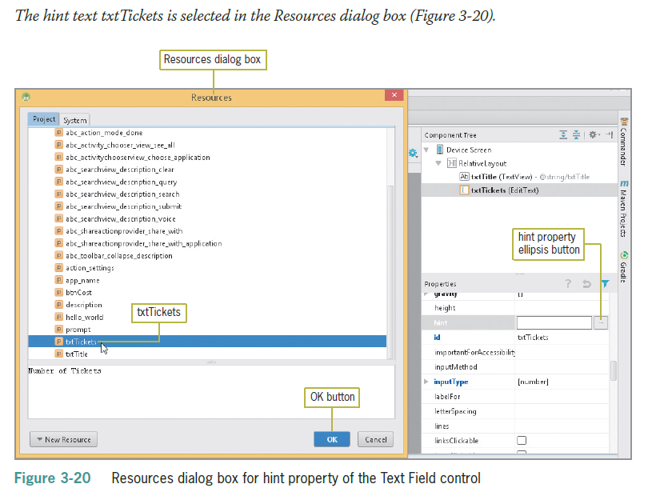
Simplifying User Input (continued)

Slide 23
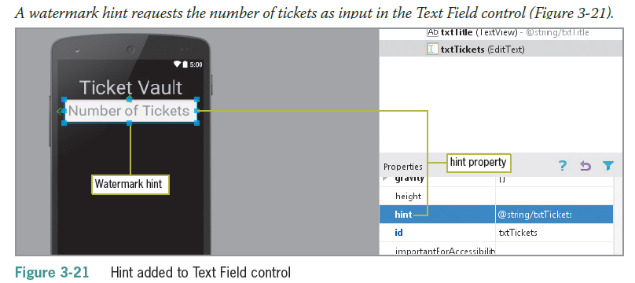
Simplifying User Input (continued)

Slide 24
Simplifying User Input (continued)
Using the Android Spinner Control
A Spinner control is similar to a drop-down list for selecting a single item from a fixed list
The spinner control displays a list of strings called items in a pop-up window
A prompt, which can be used to display instructions at the top of the Spinner control, also is stored in strings.xml and is named prompt
The Spinner property called Entries connects the String Array to the Spinner control for display in the application

Slide 25
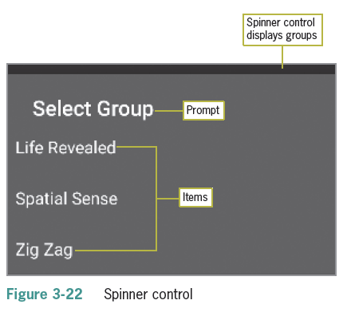
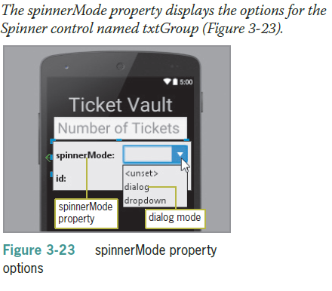
Simplifying User Input (continued)

Slide 26
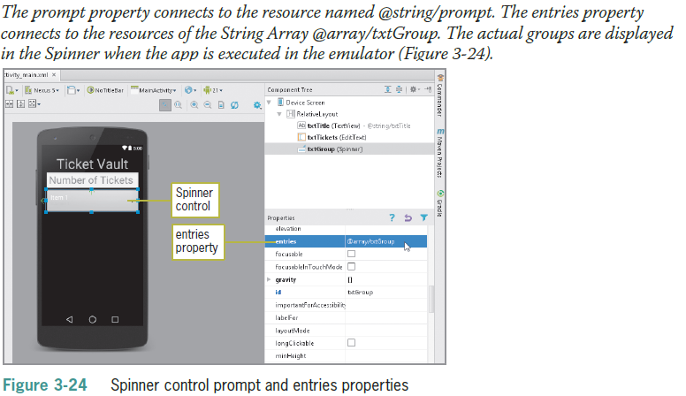
Simplifying User Input (continued)

Slide 27
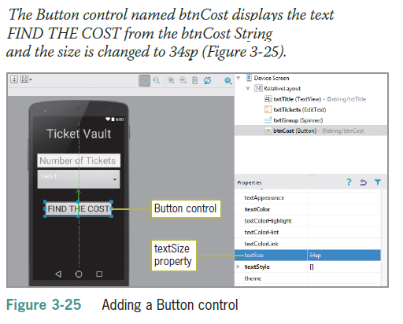
Simplifying User Input (continued)
Adding the Button, TextView, and ImageView Controls

Slide 28
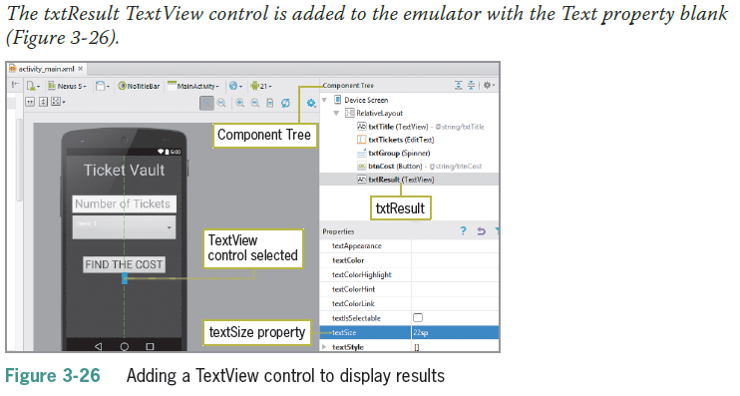
Simplifying User Input (continued)

Slide 29
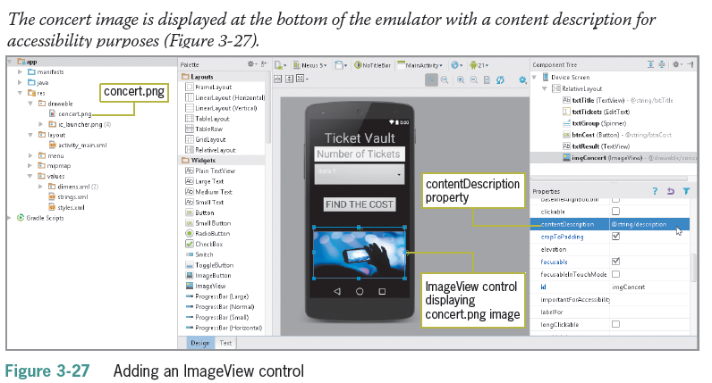
Simplifying User Input (continued)

Slide 30
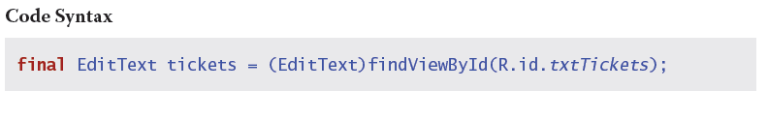
Simplifying User Input (continued)
Coding the EditText Class for the Text Field
A variable is used in programming to contain data that changes during the execution of a program
Final variables can be initialized but cannot be changed
Insert this code to create a variable:

Slide 31
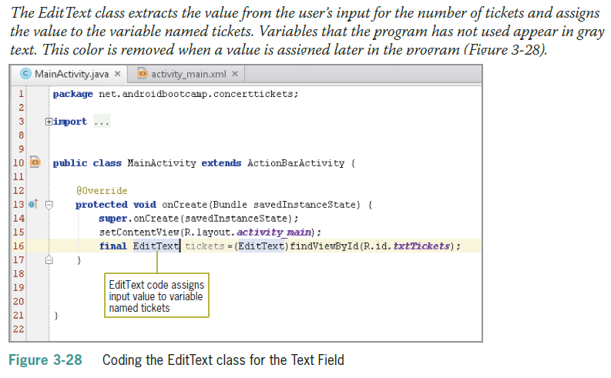
Simplifying User Input (continued)

Slide 32
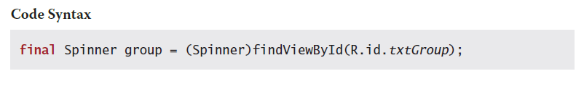
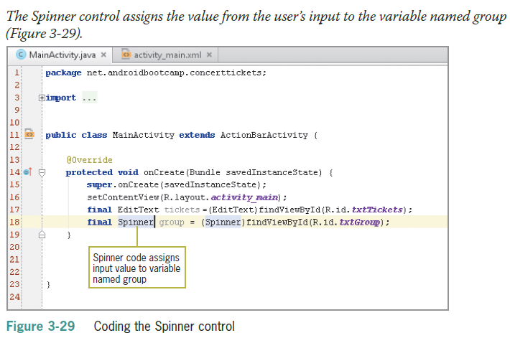
Simplifying User Input (continued)
Coding the Spinner Control

Slide 33
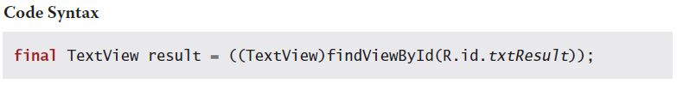
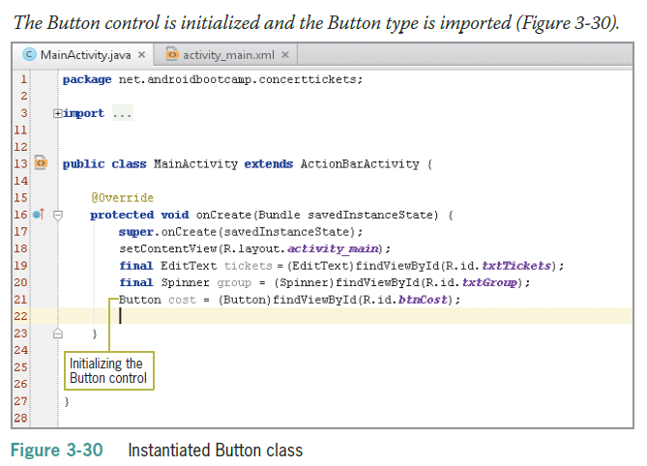
Simplifying User Input (continued)
Instantiating the Button Control

Slide 34
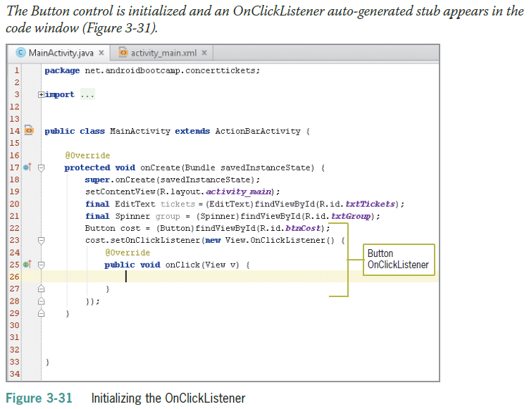
Simplifying User Input (continued)

Slide 35
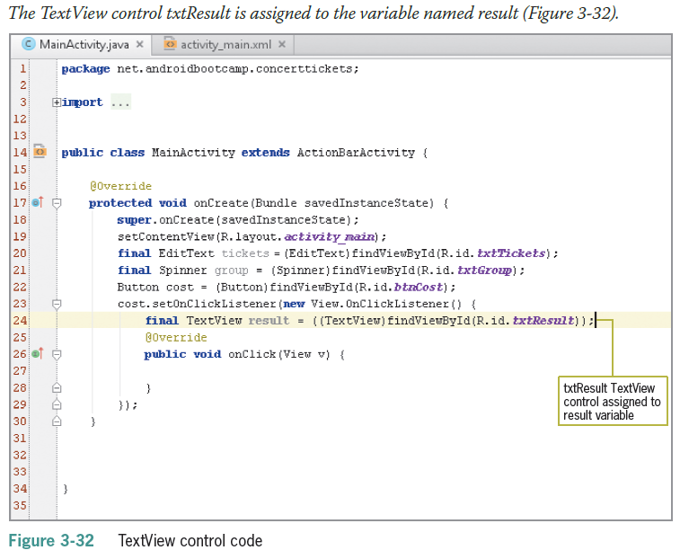
Simplifying User Input (continued)

Slide 36
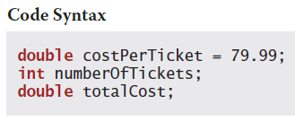
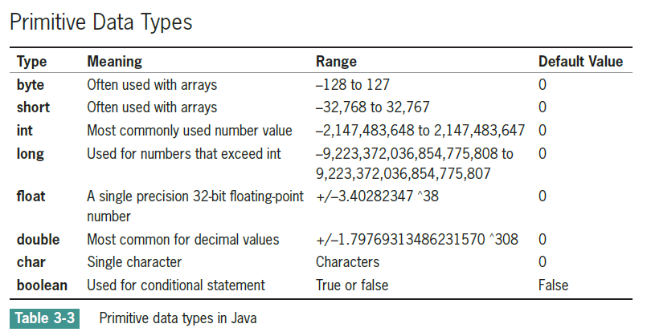
Declaring Variables
Declare the variable
Assign a value to the variable

Slide 37
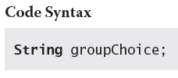
Declaring Variables (continued)
String Data Type
The String type is a class and not a primitive data type
A string can be a character, word, or phrase
Declaring the Variables
Typically declared at the beginning of an Activity
Variables must be declared before you can use them

Slide 38
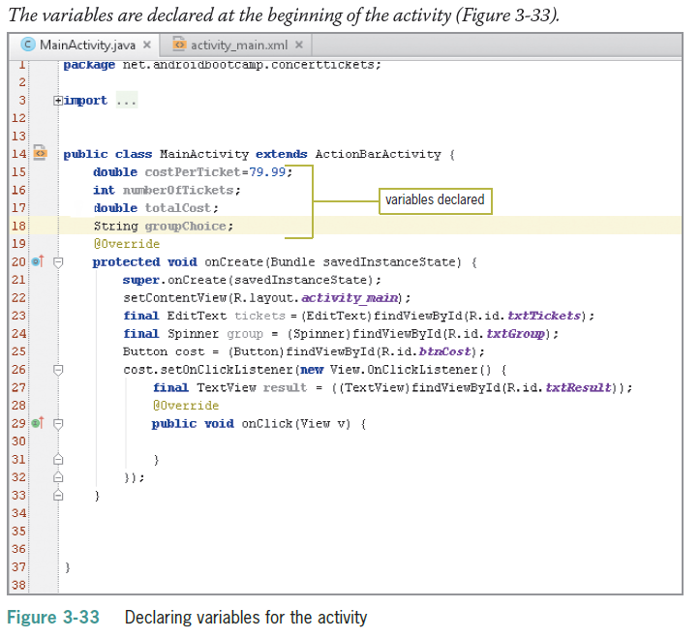
Declaring Variables (continued)

Slide 39
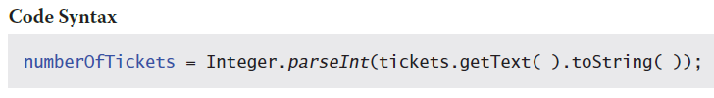
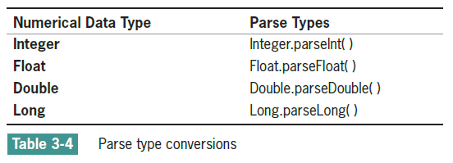
Declaring Variables (continued)
GetText() Method
Read data stored in the EditText control with the GetText() method
Data is read in as a string, by default
A Parse class is used to convert strings into numbers

Slide 40
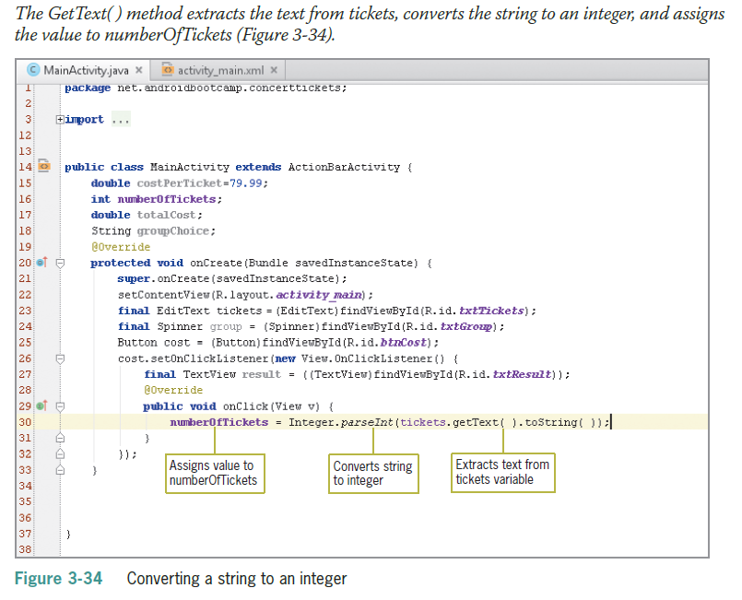
Declaring Variables (continued)

Slide 41
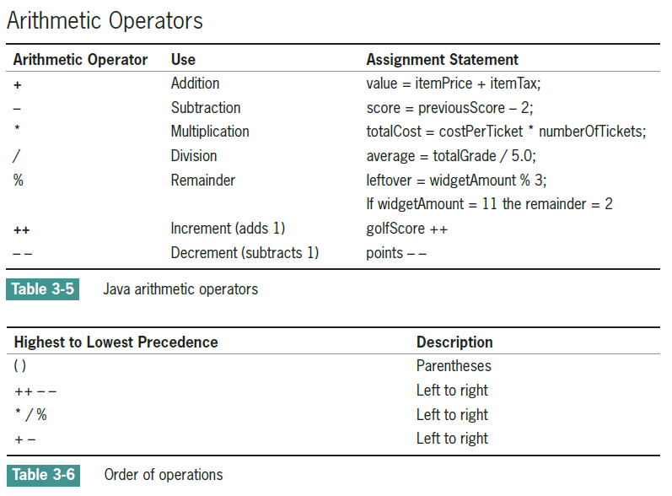
Working with Mathematical Operations

Slide 42
Working with Mathematical Operations (continued)
Formatting Numbers
Currency format requires a dollar sign, a comma (if needed), a decimal point, and two decimal places
Java has a class called DecimalFormat that provides patterns, such as $###,###.## for displaying on the Android screen

Slide 43
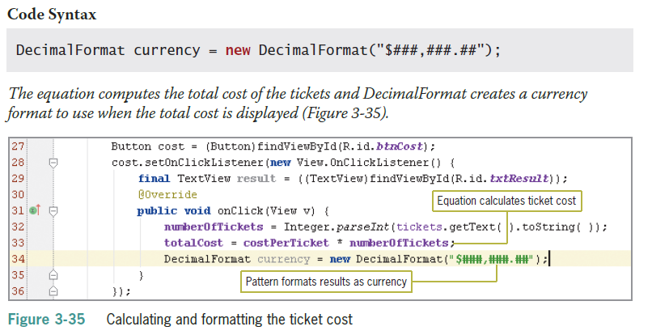
Working with Mathematical Operations (continued)

Slide 44
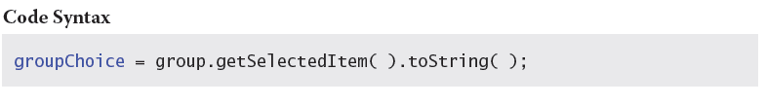
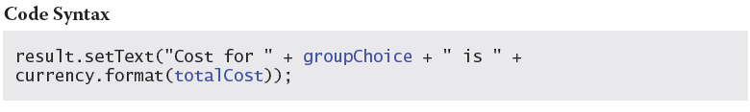
Displaying Android Output
GetSelectedItem() Method
The GetSelectedItem() method returns the text label of the currently selected Spinner item
SetText () Method
The SetText() method displays text in a TextView control

Slide 45
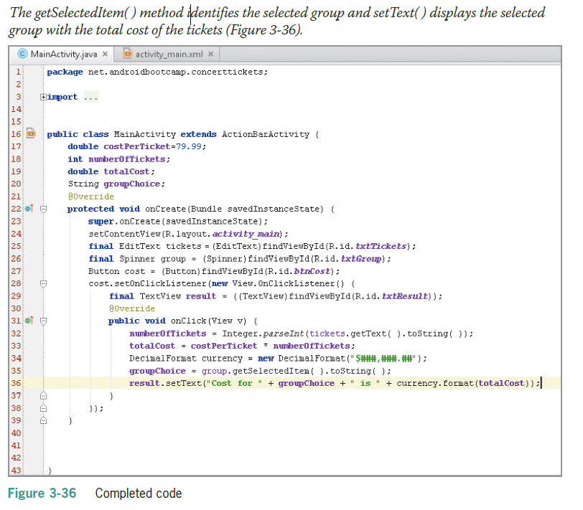
Displaying Android Output (continued)

Slide 46
Summary
Assign a theme to an Activity or an entire application to prevent apps from looking too similar
Preview a theme by tapping or clicking the AppTheme button in the emulator, and then selecting a theme
Use Text Fields to request input from users
The strings.xml file is part of every Android application by default and contains strings used in the application, such as text displayed in a TextView, Spinner, or Button control
To provide guidelines so users enter the correct data in a Text Field control, use the control’s hint property to display light-colored text, also called a watermark, describing what to enter

Slide 47
Summary (continued)
To handle the input that users enter into a Text Field control, you use the EditText class, which extracts the text and converts it for use in the Java code
To use a variable, you must first declare the variable and then assign a value to it
After assigning variables to hold the values entered in controls, you often need to convert the values in the assigned variables to the correct data type so the values can be used in calculations

